Slide 1

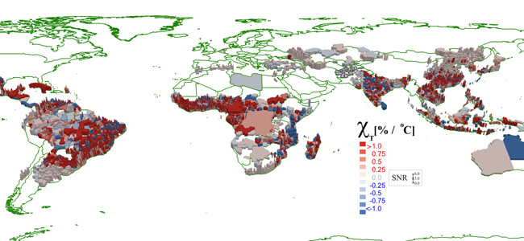
-Edward Moore
-Kyle Brown
-Alexander Smith
-Elliott Krome
Notes:
Ed

Slide 2
Contents
-Tools
-Goals and Importance
-Data
-Approach
-Problems and Pitfalls
-Visualization
Notes:
Ed

Slide 3
Tools
Notes:
Alex

Slide 4



Tools
-Python
-MATLAB
-HTML
-DIY Map app
Notes:
Alex - explain what each are for

Slide 5
Tools- Python libraries
xlrd
Allows extraction of data from Excel spreadsheets (.xls and .xlsx, versions 2.0 onwards) on any platform. Pure Python (2.6, 2.7, 3.2+). Strong support for Excel dates. Unicode-aware.
NumPy
NumPy is the fundamental package for scientific computing with Python. It contains, among other things:
a powerful N-dimensional array object
useful linear algebra capabilities
efficient multi-dimensional container of generic data
Arbitrary data-types can be defined. This allows NumPy to seamlessly and speedily integrate with a wide variety of databases.
Notes:
Alex
import xlrd
import numpy as np # np will be alias for numpy when calling numpy functions

Slide 6
Goals and Importance
-Being able to prevent the spread of diseases is important for the health of ourselves, our loved ones, and the economy.
-By modeling how other diseases spread we can make inferences about the spread of others.
-The ability to model the spread of diseases gives us invaluable information to help prevent the spread of diseases. It can tell us how much of a population needs to be vaccinated to properly protect it and how health care workers need to respond to new outbreaks.
Notes:
Elliot

Slide 7
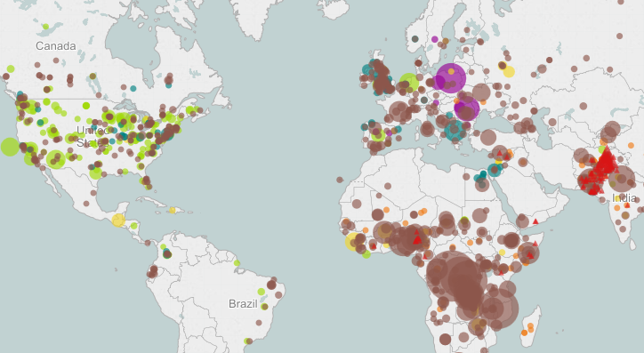
Data
-The Council on Foreign Relations website provides an interactive map illustrating the reported cases of a number of diseases, the most prevalent of which was measles.
-This site also provided
an Excel file containing
this data.

Slide 8
Approach
Notes:
eddie

Slide 9
Approach
-Since the available data does not include any ebola cases, we opted to use the most predominant disease in the data, measles, as our model for determining the world’s locations that are most likely to quickly contribute to spreading ebola and other diseases.
-Making the above assumptions, those places would require the most vaccination support to help prevent the spread of ebola.
-We decided to consolidate all city/town measles cases to the number of measles cases in each country, and correlate the number of cases in each country with that in all the other countries.

Slide 10
Approach
-We assumed that the simplest way to model how likely a disease is to spread from one country was to use a correlation matrix.
-Averaging the correlation from one country to all the others gives a probability value of how likely that country is to spread a disease elsewhere.
Notes:
ed

Slide 11
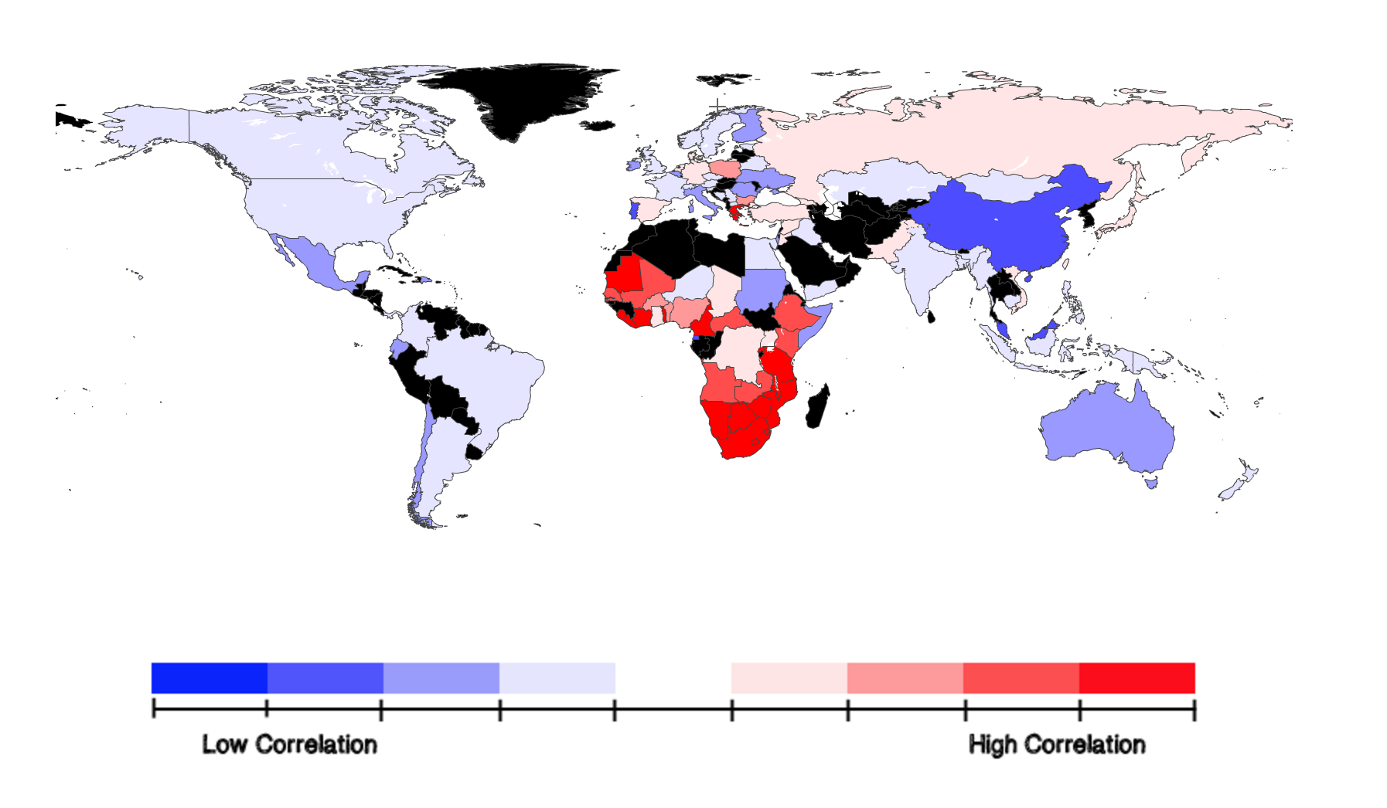
Visualization
-We placed
correlation values
for each country
into the DIY Map
Flash applet
on our webpage.
Notes:
kyle - be sure to talk about interactivity

Slide 12
Problems and Pitfalls
-Measles and ebola spread differently.
-Measles is an airborne virus that spreads through coughing and sneezing and can live up to two hours in the air.
-Ebola is spread through contact with an infected person’s blood or body fluids.
-But it proved easiest to model by country instead of city based on the best data available to us.
-Also, considering countries’ isolation being higher than their cities, it is at least a reasonable way of grouping the cases.
Notes:
kyles

Slide 13
Problems and Pitfalls
-Many countries medical records aren’t the most reliable.
-We didn’t account for vaccination rates.
-Average traffic in and out of countries are not considered along with other factors.

Slide 14
References
http://backspace.com/mapapp/
http://www.cfr.org/interactives/GH_Vaccine_Map/#map
http://www.cdc.gov/measles/about/transmission.html
http://www.cdc.gov/vhf/ebola/

